Slide 1

Walking patterns recognition under real world conditions
Russo, Nastastic, Cernigliaro, Broniarek, Alliende

Slide 2

Main research aim
Main goal: verify if there are different patterns of walking among the group members of this project.
Secondary goals:
Perform a multi-resolution analysis: analyze if the elicitation of the length of the window selected to divide the data affects the results of the classification
To make Francesco walk more than 10 minutes at once

Slide 3

Overview (probably we should remove this slide or change it?)
Test Set Error
Training Set Error
Data Collection
Data preprocessing
Bins size 1
Bins size 2
Bins size 3
Feature generation
Feature generation
Feature generation
Random Forest
LDA
Naive Bayes
Multiclass Logistic
Random Forest
LDA
Naive Bayes
Multiclass Logistic
Random Forest
LDA
Naive Bayes
Multiclass Logistic

Slide 4

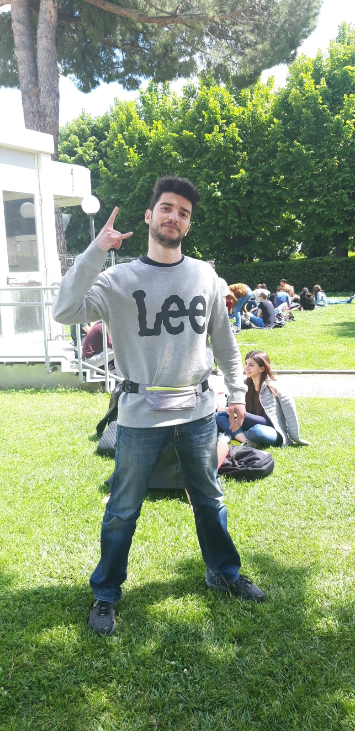
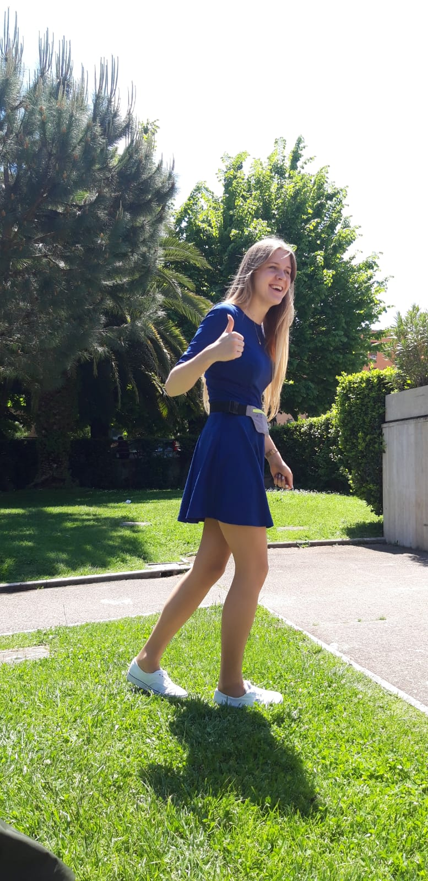

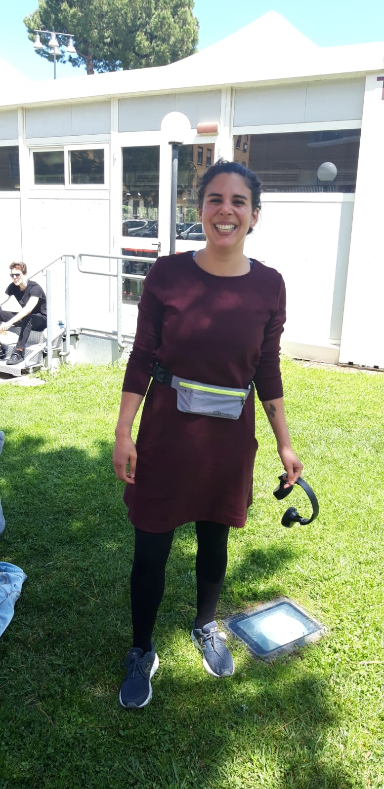

Data collection

Slide 5

The Data
5 files, one for each person of the group
About 25 minutes of recording
Used sensors:
Linear Accelerometer Sensor
Acceleration on the x axis
Acceleration on the y axis
Acceleration on the z axis

Slide 6

Data Pre-processing
Dealing with noisy data:
Removed 1 minute on the beginning and 1 minutes on the end of each recording
Time bins → Multiresolution Analysis
Window size
Overlap
Features generation: TO DO: List features(maybe in another slide)
Dealing with null-values

Slide 7
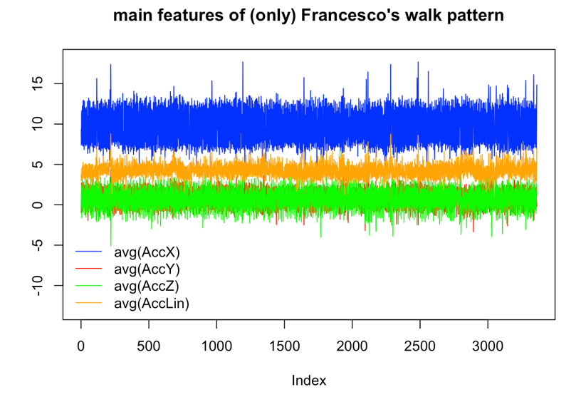

Features visualization
​ Todo
This plot is changed, use the new ones,
Add plot for each person

Slide 8


Model elicitation

Slide 9
Random Forest
Add plot for choosing n_trees parameter
Table with accuracu, sensitivit, …
Confusion matrix ?

Slide 10
For each model the similar slide….
Add plot for choosing parameter *( only for Random forest and kNN)
Table with accuracu, sensitivit, …
Confusion matrix ?

Slide 11
Summarty of all models
The last Bar plot from rmarkdown
The table with accuracies *(the same as barplot- to see numerical values)

Slide 12
Results for different window.size
The one of the last plots – accuracies vs window.size

Slide 13

conclusions
Few points from the last paragraph of rmarkdown

